Slide 1
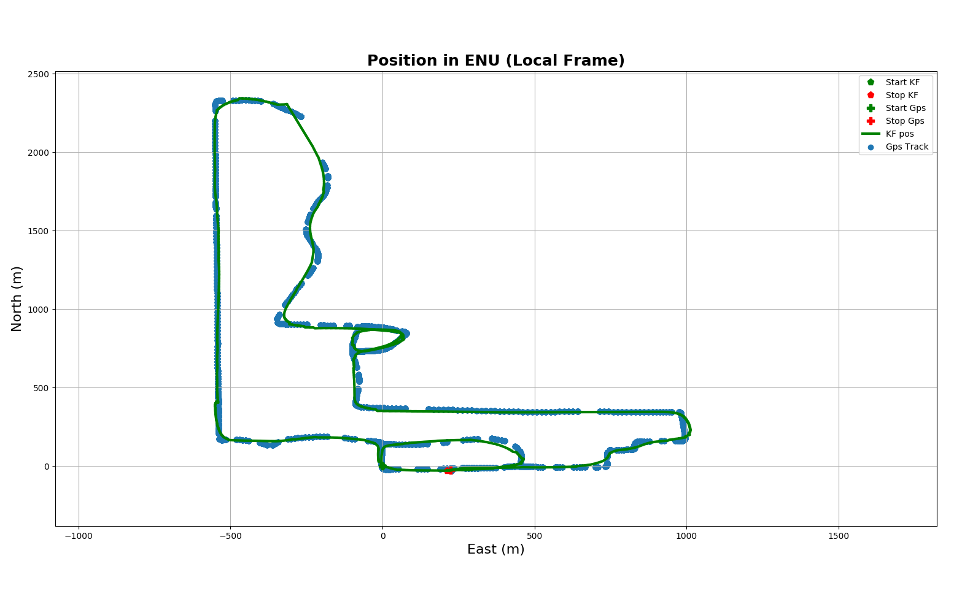
LOOP 1 – start up and 1st Loop
(2)
(3)
(1)
(1)
(5)
(4)
I turned on the device here, then waited a little bit, facing north
Drive to point (2) made a right turn (from heading north to heading (east)
Right turn (heading east to heading south)
Right turn (heading south to heading west)
Right turn (heading west to heading north) back to starting point (1) (total duration of this loop between 1 min 30sec and 2min)

Slide 2
LOOP 2 –
(7)
(8)
(9)
(10)
(6)
(2)
(3)
(1)
(5)
(4)
(10)
Started again at (1) facing north driving to (2)
Made a left turn (heading north to west) going to point
(6) Right turn (heading west to heading north)
(7) Right turn (heading north to heading east) then (After ~ 8min) (8) Slight Right turn (heading ~east to heading south-west to south following street)
(9) Left turn (heading south / southwest to heading east)
(10) Start of small loop heading east (~ 11min)

Slide 3
LOOP 3 –
(7)
(8)
(9)
(10)
(11)
(12)
(13)
(14)
(16)
(18)
(15)
(6)
(2)
(3)
(1)
(5)
(19)
(4)
(18)
(17)
(11) Made right turn and followed street to (12)
(12) Heading west and then made a left turn (now heading south)
(13) Left turn (from heading south to heading east)
(14) Right turn (heading east to heading south) (~15minutes)
(15) Right turn (heading south to heading west) following street
(16) Left turn (heading west to heading south)
(17) Immediate right turn (heading south to west)
(18) Left turn (heading west to heading south) going south for a little then following right curve (18) changing from south to west
(19) Heading west until to stop at (19) (~18min)

